Slide 1
RNA Secondary structure prediction using Stochastic context free grammars
Sudhanshu Bharadwaj

Slide 2

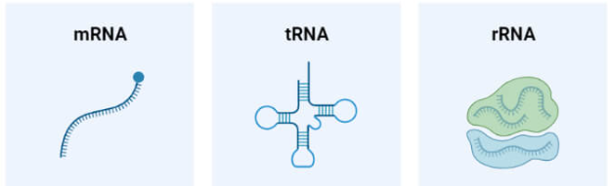
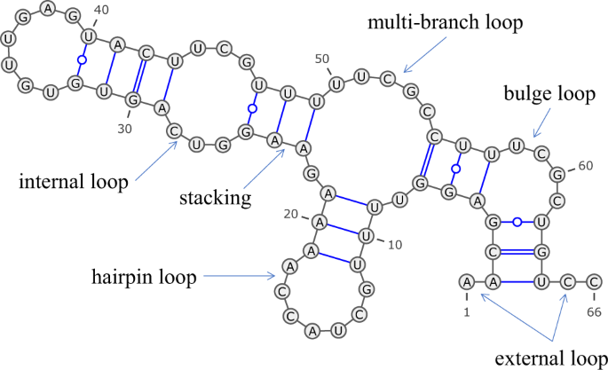
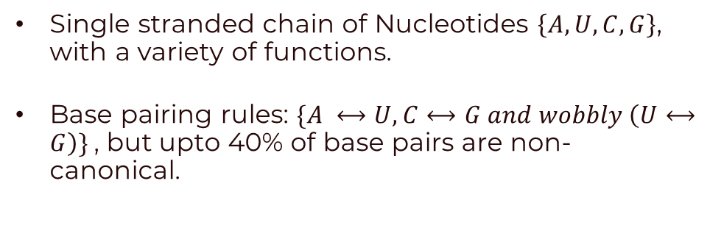
The Biology of RNA
Single stranded chain of Nucleotides $\left\{A,U,C,G\right\}$, with a variety of functions.
Base pairing rules: $\{A ⟷U,C⟷G and wobbly \left(U⟷G\right)\}$, but upto 40% of base pairs are non-canonical.
This leads to RNA adopting various secondary structures
Knowing these secondary structures is important to predict function and sometimes sufficient for our purposes.

Slide 3
So How do we predict these structures?
Given a sequence of RNA nucleotides, can we predict where secondary structural motifs will occur?

Slide 4

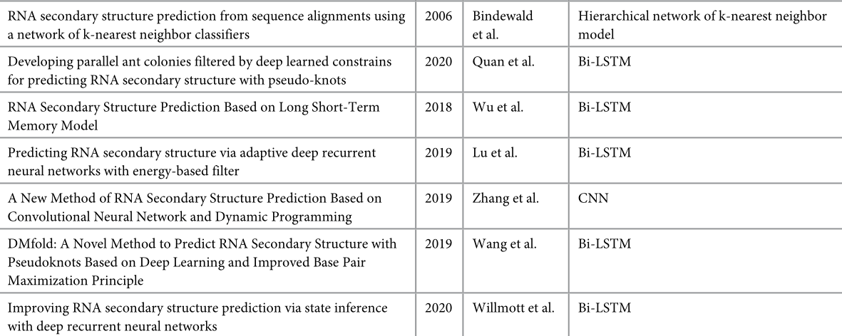
So How do we predict these structures?
Given a sequence of RNA nucleotides, can we predict where secondary structural motifs will occur?

Slide 5
So How do we predict these structures?
Given a sequence of RNA nucleotides, can we predict where secondary structural motifs will occur?
More interpretable classical algorithms
Minimize the overall energy : Zuker Algorithm
Maximize the number of base pairings : Nussinov Algorithm
Using Stochastic Context free grammars?
(Note: Pseudonots are a secondary structure that all the above methods cannot take into consideration)

Slide 6
Stochastic context free grammars?
A small detour

Slide 7
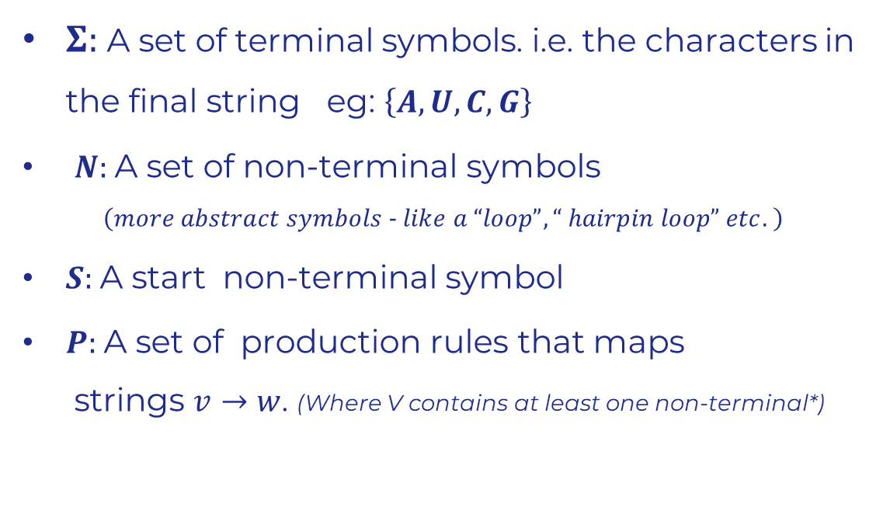
grammars
Generative
$Σ:$A set of terminal symbols. i.e. the characters in the final string eg: $\left\{A,U,C,G\right\}$
$N:$A set of non-terminal symbols $\left(more abstract symbols − like a “loop”, “ hairpin loop” etc. \right)$
$S:$A start non-terminal symbol
$P:$A set of production rules that maps strings $v→w$. (Where V contains at least one non-terminal*)

Slide 8
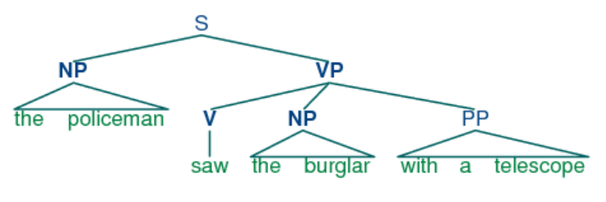
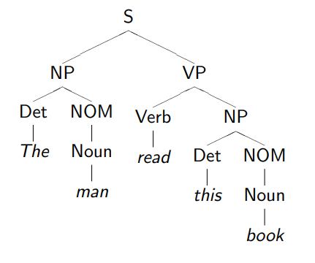
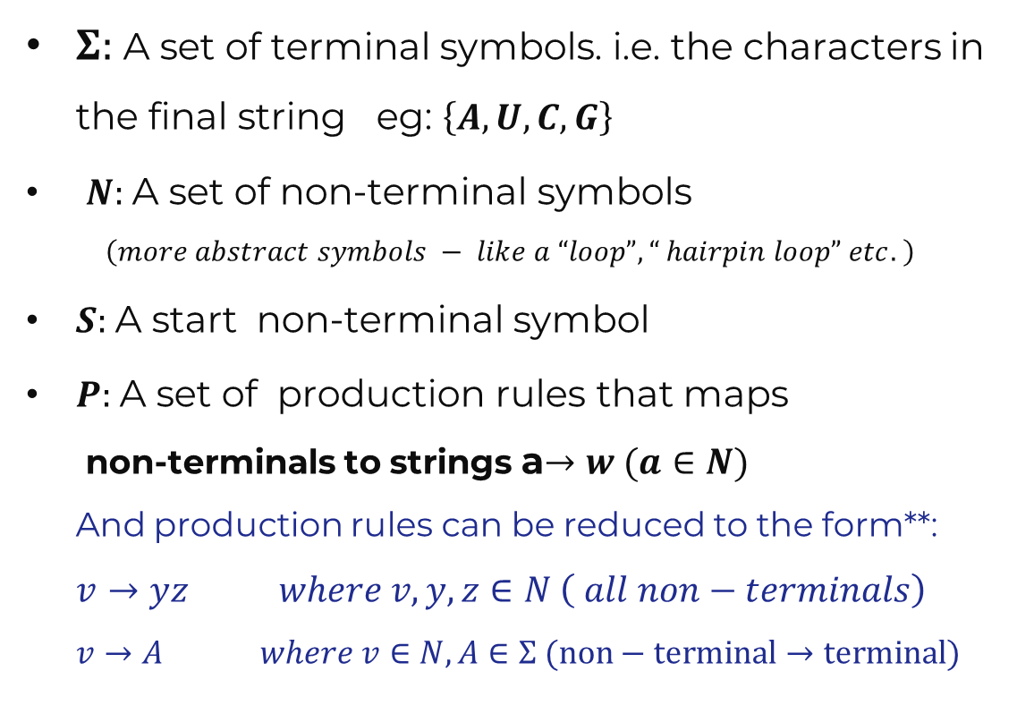
grammars
Context-Free
$Σ:$A set of terminal symbols. i.e. the characters in the final string eg: $\left\{A,U,C,G\right\}$
$N:$A set of non-terminal symbols $\left(more abstract symbols − like a “loop”, “ hairpin loop” etc. \right)$
$S:$A start non-terminal symbol
$P:$A set of production rules that maps non-terminals to strings a$→w (a∈N)$ And production rules can be reduced to the form**: $v→yz where v,y,z∈N \left( all non−terminals\right)$ $v→A where v∈N, A∈Σ (non−terminal→terminal)$

Slide 9
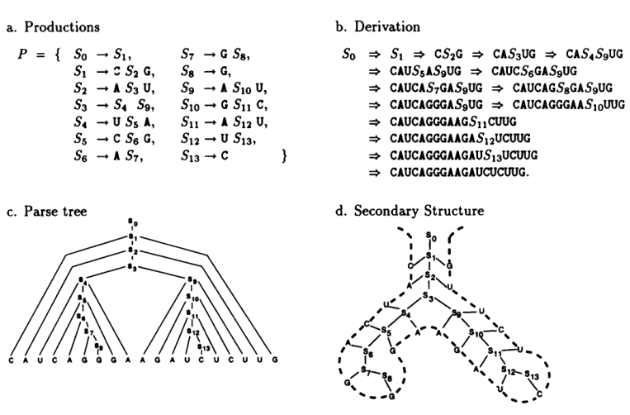
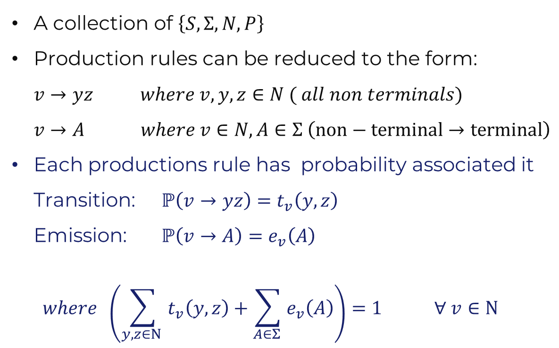
Stochastic Context-Free Grammars
A collection of $\left\{S,Σ, N, P\right\}$
Production rules can be reduced to the form: $v→yz where v,y,z∈N ( all non terminals)$ $v→A where v∈N, A∈Σ \left(non−terminal→terminal\right)$
Each productions rule has probability associated it Transition: $ℙ\left(v→yz\right)=t_{v}\left(y,z\right)$ Emission: $ℙ\left(v→A\right)=e_{v}\left(A\right)$ $where \left(\sum_{y,z∈N }{t_{v}\left(y,z\right)}+\sum_{A∈Σ }{e_{v}\left(A\right)}\right)=1 ∀ v∈N$
Notes:
This is very much like a Hidden Markov Model. Take example here of rules

Slide 10
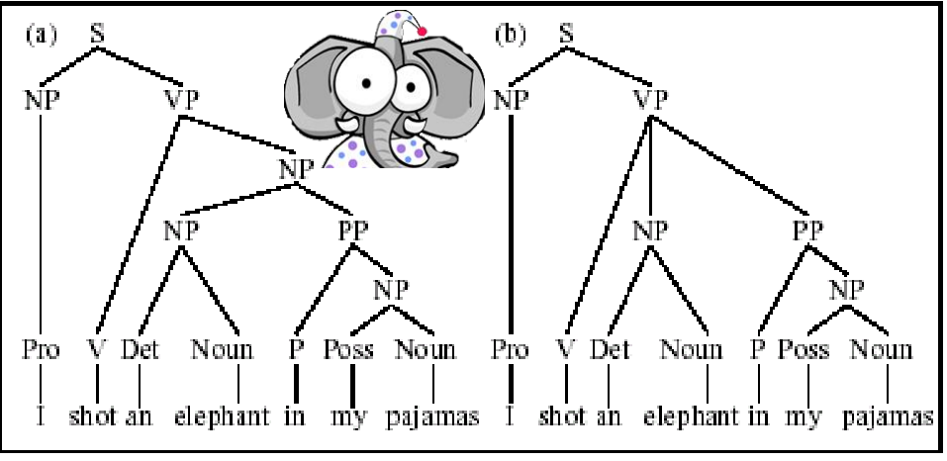
Ambiguity in Parsing
Different sets of rules can give rise to the same sequence.

Slide 11
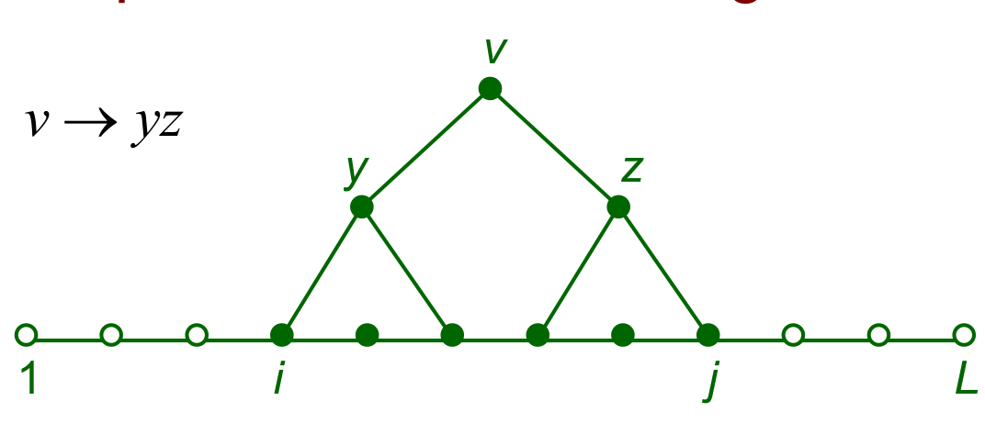

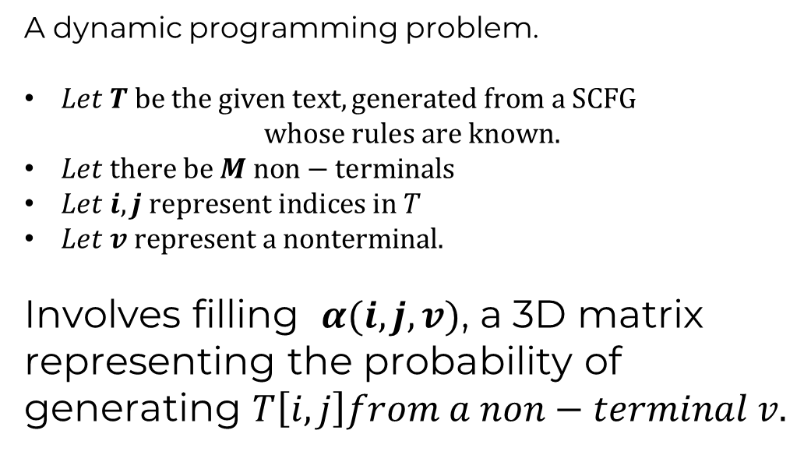
How likely is a given sequence? The Inside algorithm.
A dynamic programming problem.
$Let T be the given text, generated from a SCFG$ $whose rules are known.$
$Let there be M non−terminals$
$Let i,j represent indices in T$
$Let v represent a nonterminal.$
Involves filling $α(i,j,v)$, a 3D matrix representing the probability of generating $T\left[i,j\right]from a non−terminal v.$

Slide 12
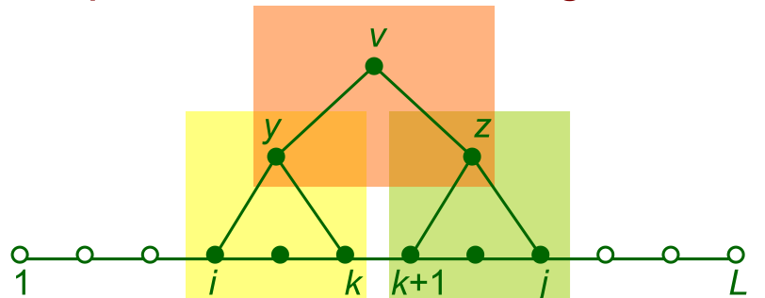
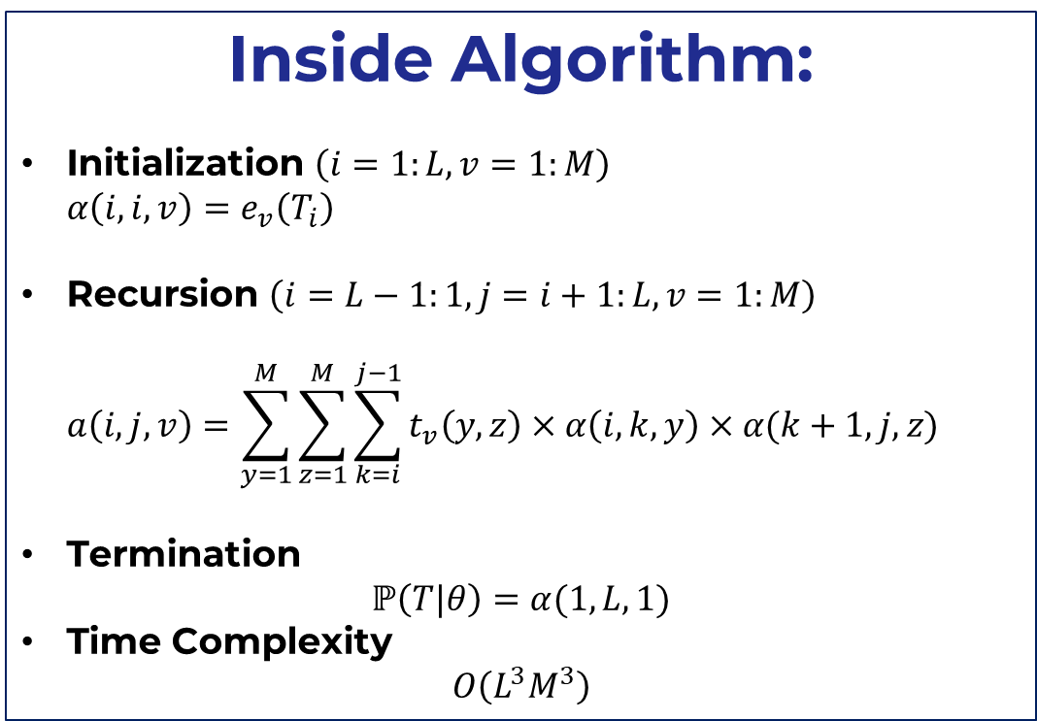
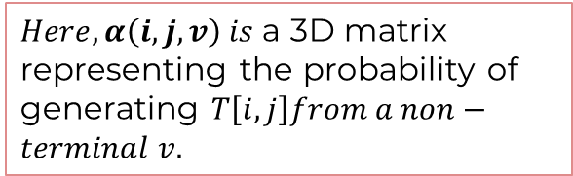
How likely is a given sequence? The Inside algorithm.
Inside Algorithm:
Initialization $\left(i=1:L, v=1:M\right)$ $α\left(i,i,v\right)=e_{v}\left(T_{i}\right)$
Recursion $\left(i=L−1:1, j=i+1:L,v=1:M\right)$ $a\left(i,j,v\right)=\sum_{y=1}^{M}{\sum_{z=1}^{M}{\sum_{k=i}^{j−1}{t_{v}\left(y,z\right)×α\left(i,k,y\right)×α(k+1,j,z)}}}$
Termination $ℙ\left(T|θ\right)=α(1,L,1)$
Time Complexity $O\left(L^{3}M^{3}\right)$
$Here, α\left(i,j,v\right) is$a 3D matrix representing the probability of generating $T\left[i,j\right]from a non−terminal v.$
Notes:
Complexity = O(L^3 M^3)

Slide 13
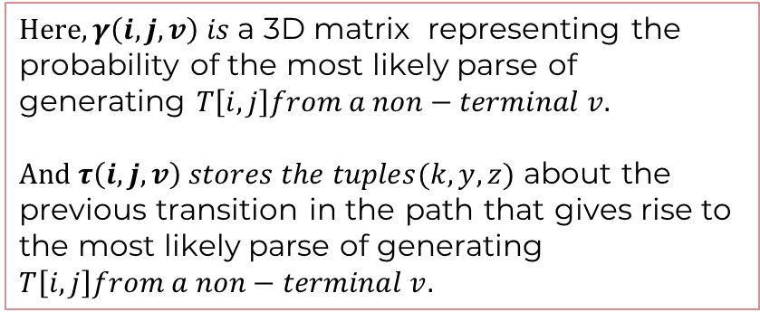
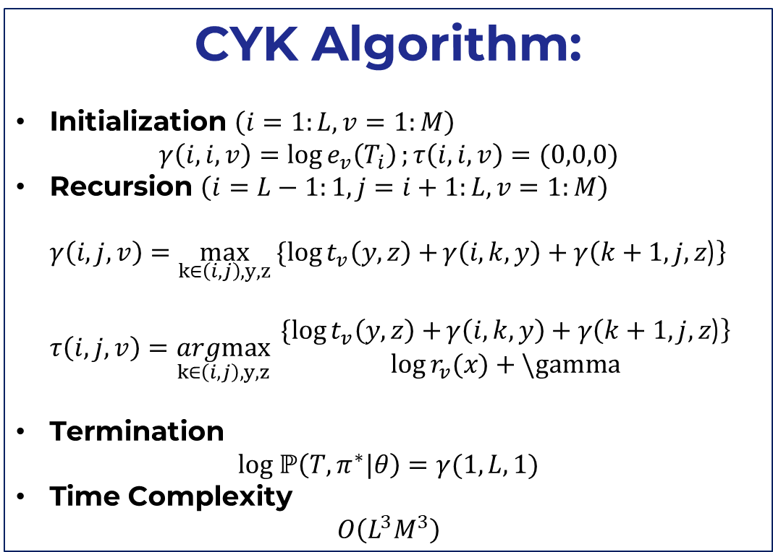
What is the most likely parse for a sequence? The CYK algorithm
CYK Algorithm:
Initialization $\left(i=1:L, v=1:M\right)$ $γ\left(i,i,v\right)=\log{e_{v}\left(T_{i}\right)};τ\left(i,i,v\right)=(0,0,0)$
Recursion $\left(i=L−1:1, j=i+1:L,v=1:M\right)$ $γ\left(i,j,v\right)=\max_{k∈\left(i,j\right), y,z}{\{\log{t_{v}\left(y,z\right)+}γ\left(i,k,y\right)+γ\left(k+1,j,z\text{)}\right\} }$ $τ\left(i,j,v\right)=\underset{k∈\left(i,j\right), y,z}{argmax}{\begin{aligned}\{\log{t_{v}\left(y,z\right)+}γ\left(i,k,y\right)+γ\left(k+1,j,z\text{)}\right\} \\ \log{r_{v}(x)}+\backslash gamma\end{aligned}}$
Termination $log ℙ\left(T,π^{∗}|θ\right)=γ(1,L,1)$
Time Complexity $O\left(L^{3}M^{3}\right)$
$Here, γ\left(i,j,v\right) is$a 3D matrix representing the probability of the most likely parse of generating $T\left[i,j\right]from a non−terminal v.$ $And τ\left(i,j,v\right) stores the tuples(k,y,z)$ about the previous transition in the path that gives rise to the most likely parse of generating $T\left[i,j\right]from a non−terminal v.$

Slide 14
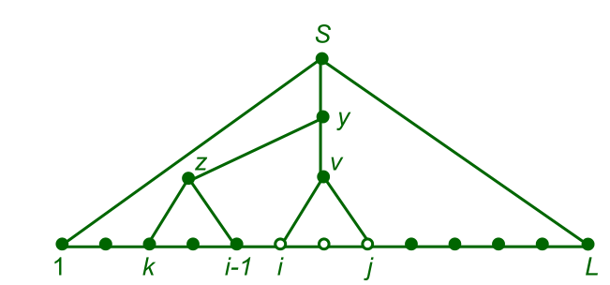


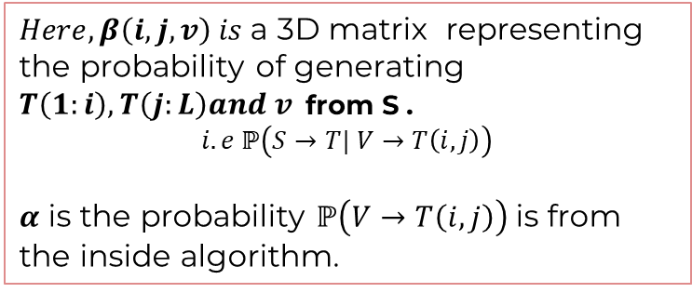
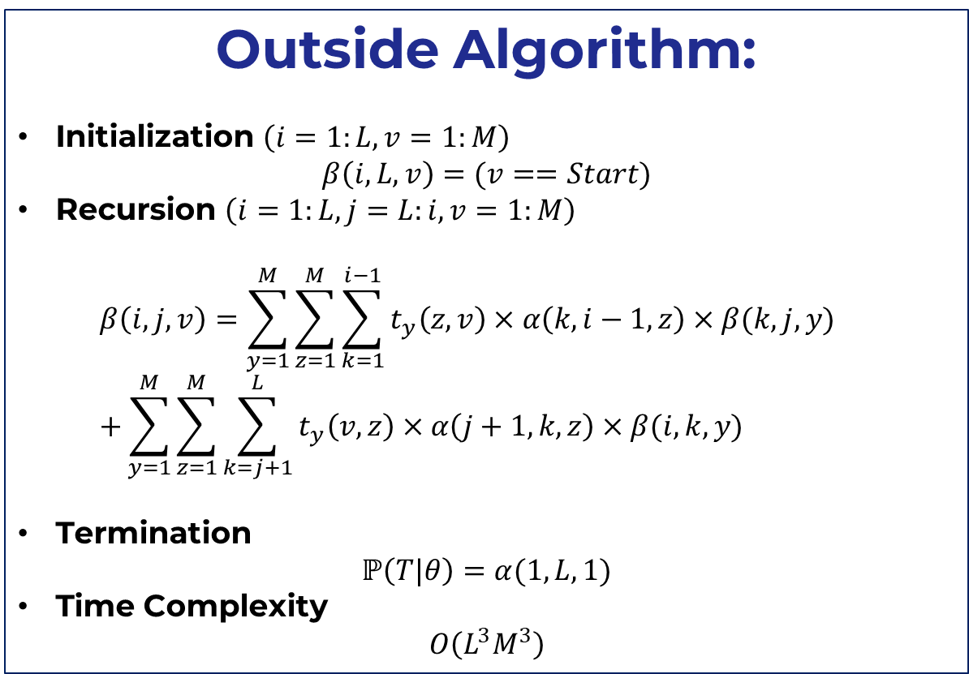
(Will be important later: For reference) The Outside algorithm.
Outside Algorithm:
Initialization $\left(i=1:L, v=1:M\right)$ $β\left(i,L,v\right)=(v==Start)$
Recursion $\left(i=1:L, j=L:i,v=1:M\right)$ $β\left(i,j,v\right)=\sum_{y=1}^{M}{\sum_{z=1}^{M}{\sum_{k=1}^{i−1}{t_{y}\left(z,v\right)×α\left(k,i−1,z\right)×β(k,j,y)}}}$ $+\sum_{y=1}^{M}{\sum_{z=1}^{M}{\sum_{k=j+1}^{L}{t_{y}\left(v,z\right)×α\left(j+1,k,z\right)×β(i,k,y)}}}$
Termination $ℙ\left(T|θ\right)=α(1,L,1)$
Time Complexity $O\left(L^{3}M^{3}\right)$
$$when \\ y→zv$$
$$when \\ y→v,z$$
$Here, β\left(i,j,v\right) is$a 3D matrix representing the probability of generating $T\left(1:i\right), T\left(j:L\right)and v$from S . $$i.e ℙ\left(S→T| V→T\left(i,j\right)\right)$$
$α$ is the probability $ℙ\left(V→T\left(i,j\right)\right)$ is from the inside algorithm.
Notes:
Complexity = O(L^3 M^3)

Slide 15
How does one learn these grammar rules and their probabilities?
But perhaps the most import question…
A lot of latent variables: Non-terminals are not observable, therefore one can’t use simple parameter estimation techniques.
Expectation Maximization: An ideal method to estimate parameters when there are a lot of latent parameters.

Slide 16
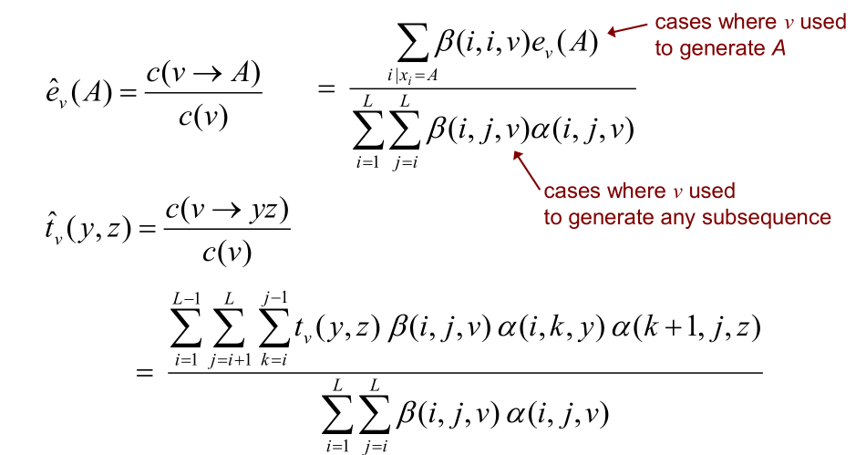
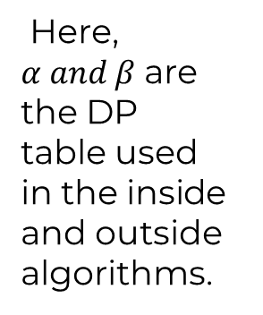
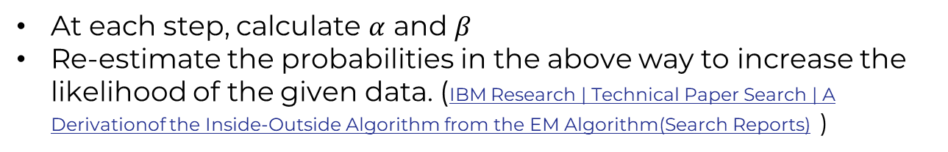
THE Inside-Outside Algorithm
Here, $α and β$are the DP table used in the inside and outside algorithms.
At each step, calculate $α$ and $β$
Re-estimate the probabilities in the above way to increase the likelihood of the given data. (IBM Research | Technical Paper Search | A Derivationof the Inside-Outside Algorithm from the EM Algorithm(Search Reports) )

Slide 17
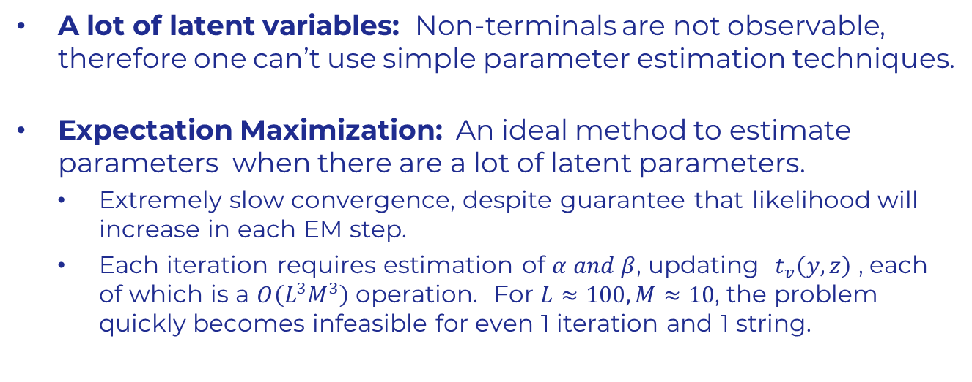
How does one learn these grammar rules and their probabilities?
But perhaps the most import question…
A lot of latent variables: Non-terminals are not observable, therefore one can’t use simple parameter estimation techniques.
Expectation Maximization: An ideal method to estimate parameters when there are a lot of latent parameters.
Extremely slow convergence, despite guarantee that likelihood will increase in each EM step.
Each iteration requires estimation of $α and β$, updating $t_{v}\left(y,z\right)$ , each of which is a $O\left(L^{3}M^{3}\right)$ operation. For $L≈100, M≈10$, the problem quickly becomes infeasible for even 1 iteration and 1 string.

Slide 18

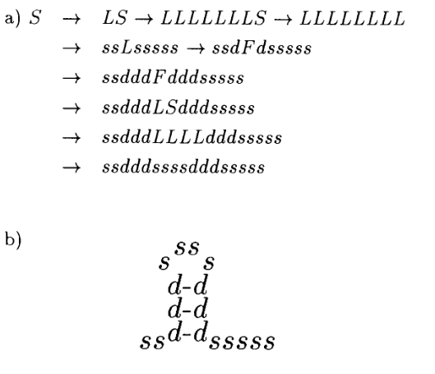
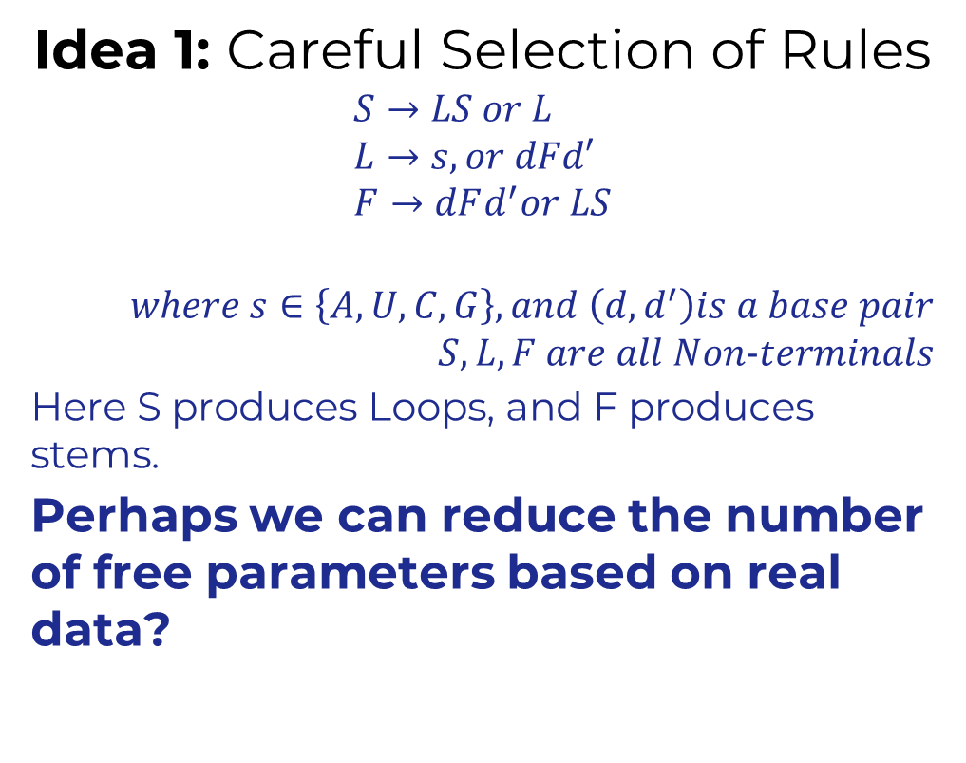
better estimation OF SCFG parameters?
Idea 1: Careful Selection of Rules
$$S→LS or L \\ L→s, or dFd′ \\ F→dFd^{′}or LS$$
$$where s∈\left\{A,U,C,G\right\}, and \left(d,d^{′}\right)is a base pair \\ S,L,F are all Non−terminals$$
Here S produces Loops, and F produces stems.
Perhaps we can reduce the number of free parameters based on real data?

Slide 19
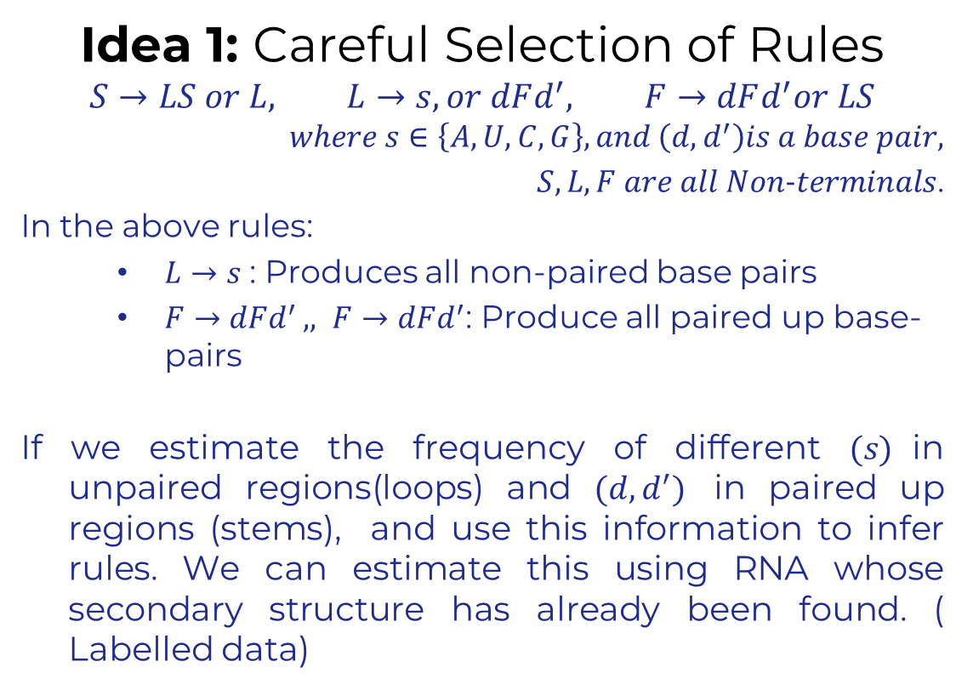
better estimation OF SCFG parameters?
Idea 1: Careful Selection of Rules
$$S→LS or L, L→s, or dFd^{′}, F→dFd^{′}or LS$$
$$where s∈\left\{A,U,C,G\right\}, and \left(d,d^{′}\right)is a base pair,$$ $S,L,F are all Non−terminals$.
In the above rules:
$L→s$: Produces all non-paired base pairs
$F→dFd^{′ },, F→dFd^{′}$: Produce all paired up base-pairs
If we estimate the frequency of different $(s)$in unpaired regions(loops) and $(d,d^{′})$ in paired up regions (stems), and use this information to infer rules. We can estimate this using RNA whose secondary structure has already been found. ( Labelled data)

Slide 20
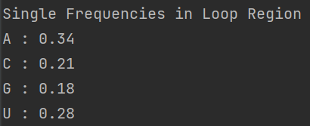
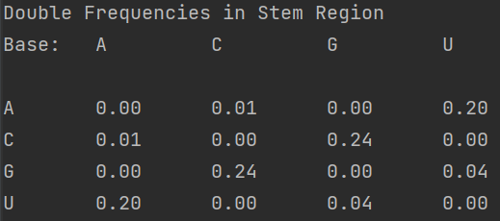
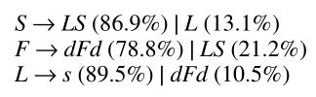
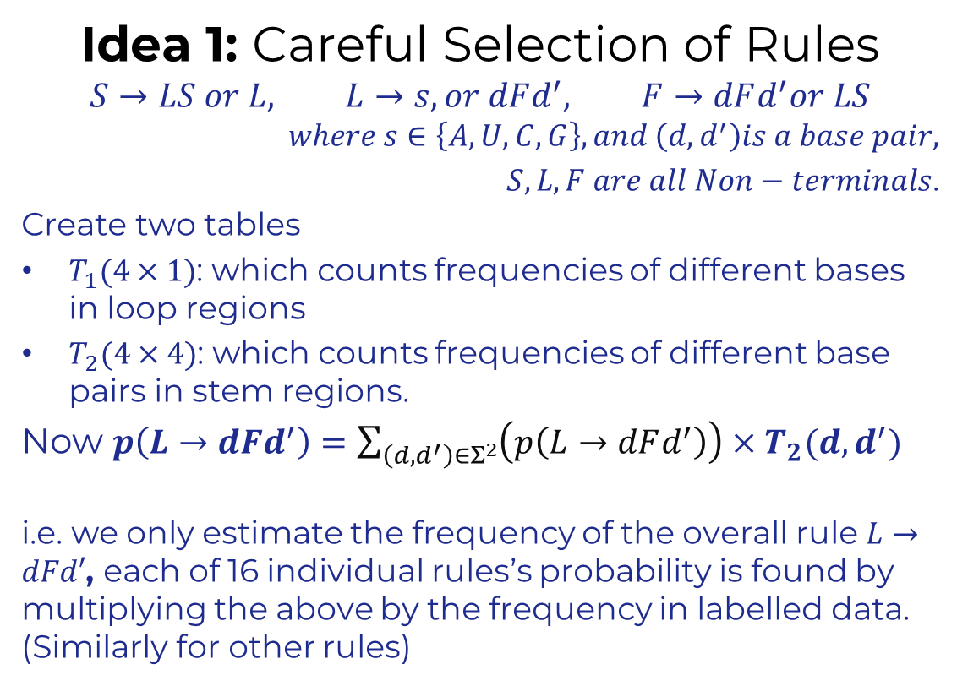
better estimation OF SCFG parameters?
Idea 1: Careful Selection of Rules
$$S→LS or L, L→s, or dFd^{′}, F→dFd^{′}or LS$$
$$where s∈\left\{A,U,C,G\right\}, and \left(d,d^{′}\right)is a base pair,$$ $S,L,F are all Non−terminals$.
Create two tables
$T_{1}(4×1)$: which counts frequencies of different bases in loop regions
$T_{2}(4×4)$: which counts frequencies of different base pairs in stem regions.
Now $p\left(L→dFd^{′}\right)=\sum_{\left(d,d^{′}\right)∈Σ^{2}}{\left(p\left(L→dFd^{′}\right)\right)}×T_{2}(d,d^{′})$
i.e. we only estimate the frequency of the overall rule $L→dFd′$, each of 16 individual rules’s probability is found by multiplying the above by the frequency in labelled data. (Similarly for other rules)

Slide 21
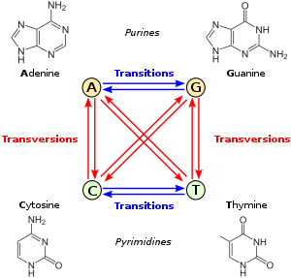
Idea 2: for better secondary structure estimation: Using similar sequences
If we take “related sequences” (this is done by constructing a phylogeny of evolutionarily similar RNA) and align them, even they will have some mutations, the secondary structure motifs are likely to be in similar places.
We can then find the probability of co-occurrences of different bases and base-pair combinations in loop/stem regions. Using this data under the assumptions of a model known as the General Reversible Model, we can estimate the mutation rates of one base/ base pair to another.
These rates depend on biological likelihood. Especially in paired up bases( stems), Transitions (which preserve base pairing) are more common that transversions.
Transitions (which preserve base pairing to some extent) are more common that transversions.

Slide 22
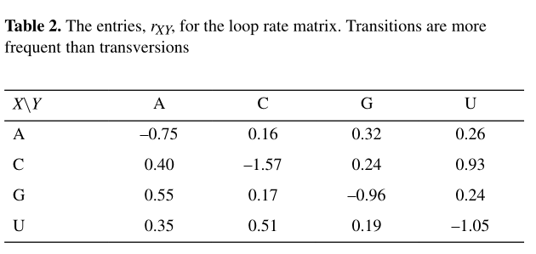
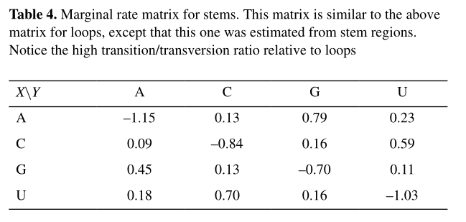
Idea 2: for better secondary structure estimation: Using similar sequences
The mutation rates are different for loops and stems because of base pairing. (These parameters can again be learnt from biological data)
Therefore, we take multiple related RNA sequence, align them and then estimate mutation rates; use this to estimate structure before
This can be incorporated with the CYK algorithm in a Bayesian fashion (details will be skipped here) to give better results.
Transitions (which preserve base pairing to some extent) are more common that transversions in paired-up bases.

Slide 23
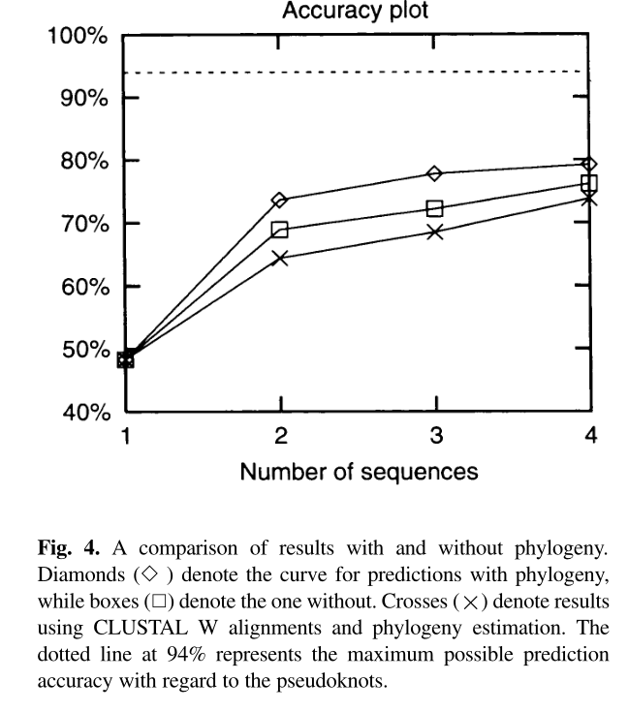
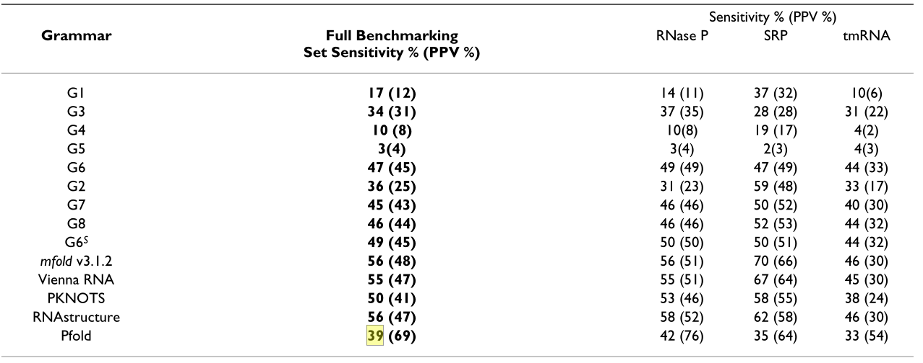
Experiments with real data
As said earlier, current approaches use Deep Learning based methods. Therefore, it was hard to find a good implementation of the above method online.
Will finish implementation and show its results in the report

Slide 24
THANK YOU
Sudhanshu B
sudhanshub@iisc.ac.in
Main References:
Knudsen, B., & Hein, J. (1999). RNA secondary structure prediction using stochastic context-free grammars and evolutionary history. In Bioinformatics (Vol. 15, Issue 6, pp. 446–454). Oxford University Press (OUP). https://doi.org/10.1093/bioinformatics/15.6.446
Bjarne Knudsen and Jotun Hein. Pfold: RNA secondary structure pre-diction using stochastic context-free grammars. Nucleic Acids Research,31(13):3423–3428, 07 2003
Several figures have been borrowed from Andrew McCallum and Anthony Gitter slides

